Slide 1


Software Engineering I CS251 Easily Buy, Sell, Exchange Products web-application 2014 TA: Catherine Bedrossian Dr.: Mohamed El_Ramly

Slide 2
What will be discussed ?
Project objective
Project requirements
Software design
Implementation of the software
Demo of the system
challenges ,difficulties and lessons learned
What we can do next time

Slide 3
Project objective
Display, marketing and purchase products via the Internet without commission and the cost that paid at any other means of advertisements.
Allow people to buy and sell (exchange items) with each other

Slide 4
Project requirements
Provide a website, where user can post anything he wants to sell and can search on any goods he is interested to buy.

Slide 5
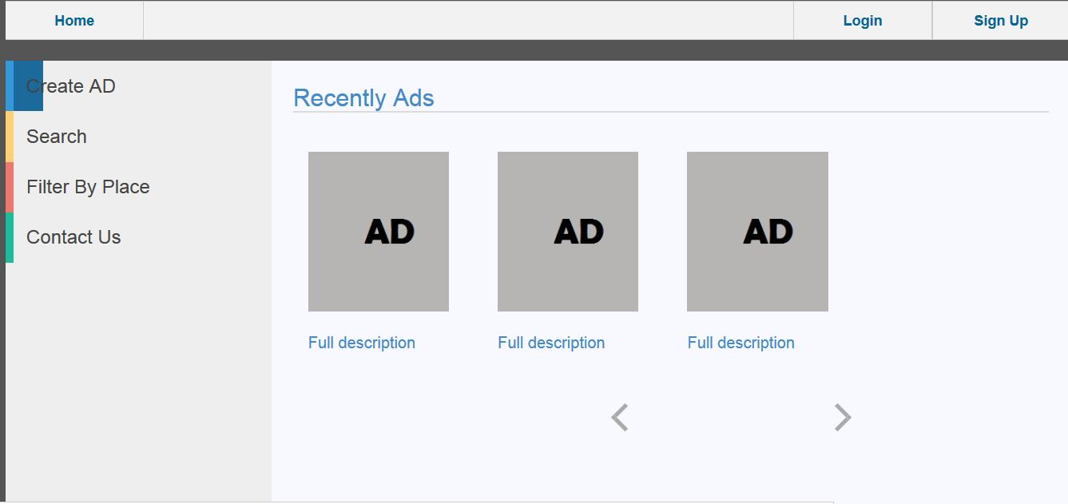
Software design

Slide 6
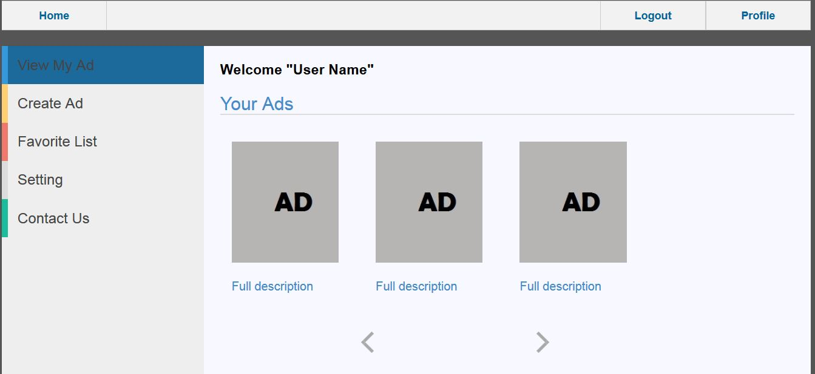

Slide 7
Implementation of the software
The website implemented using PHP scripting language, HTML developing language, CSS designing language and MYSQL for the database

Slide 8
Demo of the system
Sample surfing through the web-site

Slide 9
challenges ,difficulties and lessons learned
challenges :- learn a new technology , make a good plan to complete the project , stick to the time plan
difficulties :- accomplished the tasks in time
lessons learned :- team working follow the plan and cooperation. Software Engineering is the base of any Software Project

Slide 10
What we can do next time
More improved requirements documentation
More ease at the design
Learn a new Software engineering methods
Work on a larger projects

Slide 11


Slide 12
Team members
ID | Name | Email | Mobile
20120364 | Mahmoud Mohamed Hadad | hooda_fci@yahoo.com | 01117943793
20120207 | Sherif Mohamed Farouk | sfarouk513@gmail.com | 01144967048
20120030 | Ahmed Sayed Eid | medo.shahin15@gmail.com | 01129254603
20120062 | Ahmed Mohamed Fekry | ahmedfikry78@gmail.com | 0112059041

